Slide 1

Mice Protein Expression Data
Prediction of Mice Protein Expression Class Feature using Machine Learning Models.

Slide 2
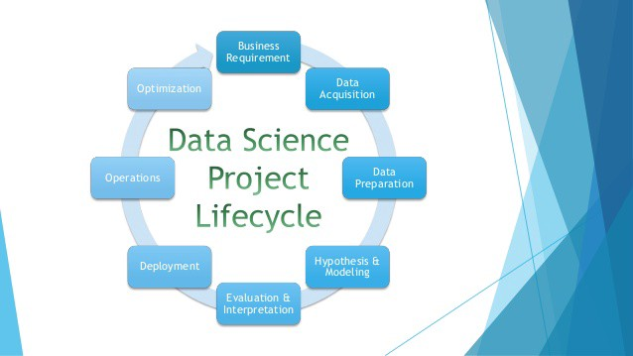
Index
Overview and Preparation of Data
Exploration of Data
Feature selection and feature Engineering
Modelling the Data
Model Comparisons
Results and conclusions

Slide 3
Overview and Preparation of Data
Data was sourced from UCI repository.
The Data set contains mice protein expressions data.
Data set contains 77 numerical and 4 categorical variables
The class variable is a dependent feature of the provided categorical features
We aim to derive the class variable using the protein information.

Slide 4
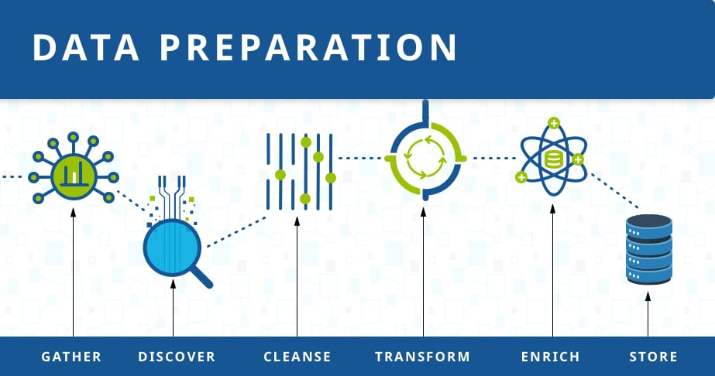
Data Preparation: Checking irregular cardinalities and null values
In the given data set the mouse ID and measurement feature is observed to be combination of ID and the measurement of the mouse
Hence we separate the features and store the data set for further explorations.
Some missing values are found in the numerical features of the data set.
These features are imputed by the mean value of that feature.
The clean data set is now obtained which can be used for exploration.

Slide 5

Data Exploration
To gain some insights of the data, we explore the features of the data.
Data exploration for this project is done on the univariate as well as bivariate data.
Univariate explorations contains single column features to observe their distribution.
Bivariate explorations we choose 10 pairs of columns and plot the instances using python libraries and conclude our hypothesis regarding the same.

Slide 6
Data Explorations: Univariate Exploration
Since we have more numerical features in the data set, we explore the data using histograms and box plots.
Univariate data explorations lets us understand the skewness of the features, their median and quartile ranges.
Exploring the protein expressions namely, 'DYRK1A_N', 'ITSN1_N', 'BDNF_N', 'NR1_N', 'NR2A_N’ using histograms we understand their value ranges and the frequency.

Slide 7
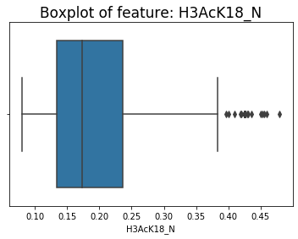
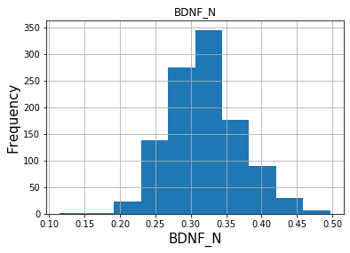
Data Exploration: Univariate Exploration
Features 'BDNF_N', 'NR1_N', 'NR2A_N’ were found to be normally distributed.
Features `DYRK1A_N` and `ITSN1_N` shows right skewed distribution of the values.
Similarly some boxplots of features were also plotted.
The figure shows a boxplot of the feature H3aCK18_N which contains outliers.
The figure shows a sample data exploration graph of and normalized feature 'BDNF_N
Likewise the graphs of other features can be plotted and explored.

Slide 8
Data Exploration: Bivariate Data Exploration
Bivariate exploration of features allows us to explore pair of features.
These type of explorations extends our capability to explore relationship between features.
10 pair of features, some numerical and some categorical were chosen.
The features were plotted using the matplot lib and seaborn features of python language.
Plausible hypothesis were formulated based on the results of the explorations.

Slide 9
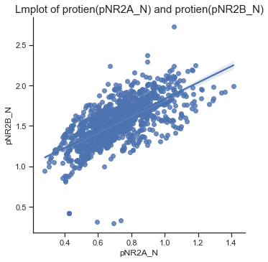
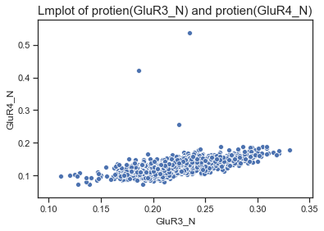
Data Exploration: Bivariate explorations
It was found that the protein(pNR2A_N) value increases with the increase in the value of protein(pNR2B_N) within range slightly below 1.0 to slightly below 2.5.
It was observed from the following graph that there is a visible linear increase in the value of protein GluR3_N with the increase in the value of protein GluR4_N. However, the bandwidth of increase is narrow.
similarly other features of the data set were explored and plausible hypothesis was stated.
We can see the graphs of the relationship of protein(pNR2A_N) and protein(pNR2B_N) and GluR3_N and protein GluR4_N.

Slide 10
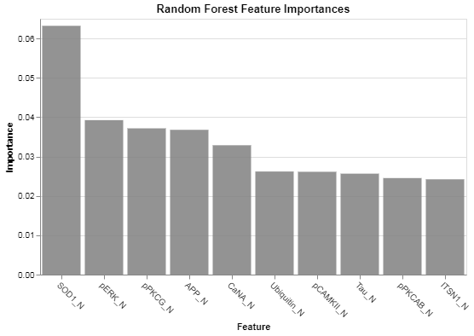
Feature Selection and Feature Engineering
After data exploration we extract the top features of the data so as to have insights while modeling the data.
We use Random Forest Importance(RFI) method to find the most important features.
Random forest use ensembling technique to decide the most important features by using series of decision trees(n_estimators)
Based on the scores of every individual column we plot the most important features and pass it as a parameter while tuning the algorithms.
The top 10 features we found as below : ['SOD1_N', 'pERK_N', 'pPKCG_N', 'APP_N', 'CaNA_N', 'Ubiquitin_N','pCAMKII_N', 'Tau_N', 'pPKCAB_N', 'ITSN1_N']

Slide 11
Modelling the Data
Supervised learning models were used to model the data and predict the class target labels.
Since we aim to label the class features based on the protein information, we drop all the categorical features from the data set.
Two models K-Nearest Neighbor and Decision Tree are implemented and their performances are compared in this project.
K-Nearest Neighbor – Classification algorithm which predicts the labels by calculating the distance metrics of the nearest neighbors.
Decision Tree – A Decision Tree is a supervised predictive model that can learn to predict discrete or continuous outputs by answering a set of simple questions based on the values of the input features it receives

Slide 12
Modeling the Data: Test Train Split
Both the models KNN and DT are trained on the training data and are tested on the unseen testing data.
To obtain greater accuracy value, we divide the data set in 70-30 portion with 70% training data and 30% testing data.
The target feature is separated for training and testing purposes and stored in order to provide as an input to the classification models.
Cross Validation Platform: K-Fold cross validation strategy with k=5 i.e 5 folds are used for cross validation in order to avoid overfitting of the data.
Cross validation technique is later provided as an input in the exhaustive search methodology.

Slide 13
Classification Model 1: KNN Algorithm
KNN algorithm compares the observation with the metrics of the nearest observation and classifies the labels based on the nearest value.
We observe the KNN accuracy on the extracted training data from the data set.
Pipelining method is used to pass RFI feature selection and KNN so that the selected most important features are provided as an input to the algorithm.
GridSearch function is used to perform exhaustive search based on the cross validated platform and the parameters specified for fine tuning of the algorithm.

Slide 14
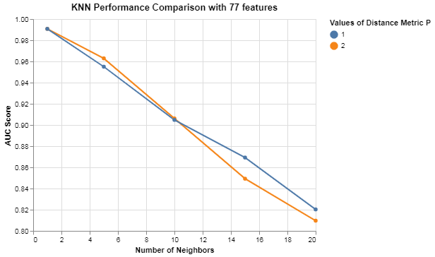
KNN results on Training Data
The hyper-parameter values of the KNN algorithm include number of neighbors, the value of ‘P’ and number of features.
After fine tuning these parameters using the pipleline method, we find that KNN yields an accuracy score of 0.99 with features :
Number of neighbors : 1
Number of features : 77
Value of P : 1
Hence we plot the top performance accuracies of the KNN on an Altair graph to have an overview of KNN

Slide 15
Classification Model: Decision Tree
Decision Tree is a supervised predictive model that can learn to predict discrete or continuous outputs by answering a set of simple questions based on the values of the input features it receives.
We observe the DT accuracy on the extracted training data from the data set.
Pipelining method is used to pass RFI feature selection and DT so that the selected most important features are provided as an input to the algorithm
GridSearch function is used to perform exhaustive search based on the cross validated platform and the parameters specified for fine tuning of the algorithm.

Slide 16
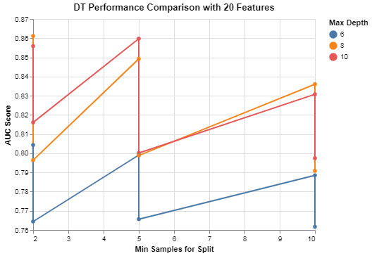
Decision Tree results on Training Data
The hyper-parameter values of the DT algorithm include split criterion , Maximum depth, Minimum Sample Split.
After fine tuning these parameters using the pipeline method, we find that DT yields an accuracy score of 0.85 with features :
Split Criterion: Entropy
Max depth : 1
Minimum Sample Split: 2
Number of Features: 20

Slide 17
Model Performance on testing Data
Since we have fine tuned the models on the training data, now we test the models on the unseen testing data.
The 30% test data is provided as an input to the tuned models.
The predict function in the sklearn library is used to predict the scores of the models on the unseen data.
After testing the models on unseen data the following accuracy scores were obtained:
KNN : 0.932
DT: 0.715

Slide 18
Model Comparisons
It was observed that the KNN model outperforms the Decision tree algorithm in training as well as testing data on cross validated platform.
The KNN algorithm outperforms the Decision tree by 21% accuracy
The KNN algorithm works by mapping the K nearest values of any observation, where as a Decision tree algorithm splits the data based on the criteria and the features of the provided data set.
Hence it can be said that KNN performs better on the numerical data than on categorical data.

Slide 19
Results and conclusions
On a cross validated platform on all the protein features, KNN algorithm after hyper-parameter tuning was found to be most effective as compared to the Decision tree algorithm.
Although the Class feature is a multivariate feature and can be predicted on the categorical features such as Genotype, treatment and behavior, we predicted the class labels based on all the protein information features present in the data set.
For the numerical protein features our trained KNN model was found to be most effective with an accuracy score of 93% on the unseen testing model.
Hence we can conclude that for the mice protein expressions predictions, KNN model can be used for predicting the multivariate class labels.

